Slide 1



UNIVERSITY INSTITUTE OF ENGINEERING
COMPUTER SCIENCE ENGINEERING
Bachelor of Engineering
Cloud Computing(20CST-411 )
Prepared By: Er.Neetu Bala(E15382)
Topic: Grid and Utility Computing
DISCOVER . LEARN . EMPOWER

Slide 2
Learning Objectives & Outcomes
Objective:
To understand the meaning of Grid and Utility Computing
Outcome:
Student will understand
The meaning of Grid and Utility Computing
How its works

Slide 3

Grid Computing

Slide 4
Overview
What is Grid Computing?
How does Grid works
View of Grid environment
Why do we need Grid Computing?
Grid Computing v/s Cloud Computing
Advantages
Disadvantages
Example
Conclusion

Slide 5
What is Grid Computing
A distributed computing system.
Where a group of computers are connected.
To create and work as one large computing power, storage, database, application, and service.

Slide 6
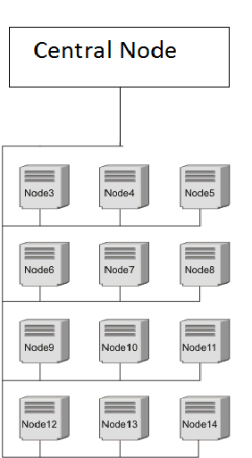
How Grid Works

Slide 7
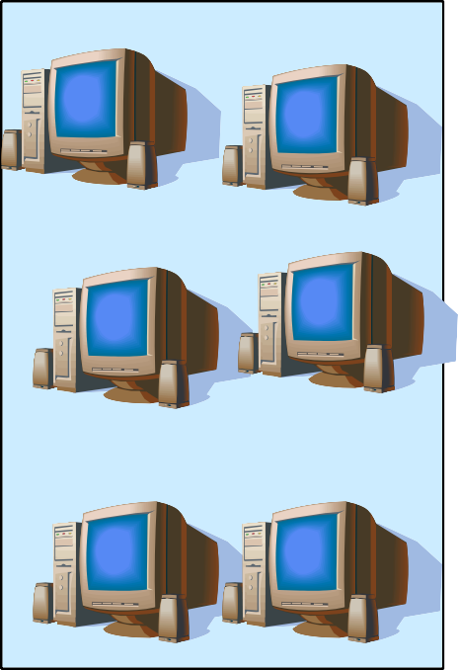

A typical view of Grid environment
Grid Information Service
Grid Information Service system collects the details of the available Grid resources and passes the information to the resource broker.
Details of Grid resources
Computational jobs
Grid application
Processed jobs
Grid Resources
Grid Resources
(PC, Supercomputer, database, ins
Computation result
User
Resource Broker
A Resource Broker distribute the jobs to the available Grid resources based on user’s requirements for further executions.
A User sends the task to Grids in order to speed up the execution of the application.
truments, etc.) in the Global Grid
execute the user jobs.
5

Slide 8





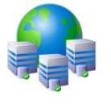



Why do we use Grid computing
Many large scale problems can not be solved
by a single computer
Globally distributed data and resources

Slide 9






Grid computing v/s Cloud computing
Grid Computing divide a huge task into a lot of independent and no related
subtasks, and then let every node do the jobs. Even any node fails the process is not affected.
In Cloud computing a user may apply resource from the resource pool to deploy its application,
not submit its task to grid and let the grid complete it.

Slide 10
Advantages
Can solve larger, more complex problem in a shorter time.
Easier to collaborate with other organizations.
Make better use of existing hardware.

Slide 11
Disadvantages
Grid software and standards are still evolving
Non-interactive job submission
Confidentiality interrupted

Slide 12

Conclusion
By implementing the Grid it is very easy
to download multiple files very fast
Further implementations could be carried out in the nearest future
11

Slide 13

Utility Computing

Slide 14
What is Utility Computing
Utility computing allow the user to pay per use means whatever they are using only for that they have to pay.
It is a plug in that needs to be managed by the organizations on deciding what type of services has to be deployed from the cloud.
Utility computing allows the user to think and implement the services according to them.

Slide 15
How Utility Computing works
The principle of utility computing is very simple: One company pays another company for computing services. The services might include hardware rental, data storage space, use of specific computer applications or access to computer processing power.
Many utility computing companies offer bundles or packages of resources. A comprehensive package might include all of the following:
Computer hardware, including servers, CPUs, monitors, input devices and network cables

Slide 16
Need of Utility Computing
Promises to address pressing business needs, including making the business more agile, adaptive, and flexible; and, more importantly, able to treat IT as an increasingly variable cost. The aim of utility computing is to reduce IT costs.
Can be supplied in small, incremental bites that deliver fast, demonstrable, significant return on investment, so companies don't have to wait for the full implementation to achieve payoffs. Much shorter time to market.
Provides total flexibility in implementation, from in-house and self-managed to fully outsourced, with everything in-between—including a hybrid deployment model in which in-house capacity can be supplemented by third-party resources to handle peak needs.

Slide 17
Advantages
The client doesn't have to buy all the hardware, software and licenses needed to do business. Instead, the client relies on another party to provide these services.
Utility computing gives companies the option to subscribe to a single service and use the same suite of software throughout the entire client organization.
Another advantage is compatibility. In a large company with many departments, problems can arise with computing software. Each department might depend on different software suites. The files used by employees in one part of a company might be incompatible with the software used by employees in another part.

Slide 18
Disadvantages
Potential disadvantage is reliability. If a utility computing company is in financial trouble or has frequent equipment problems, clients could get cut off from the services for which they're paying.
Utility computing systems can also be attractive targets for hackers. A hacker might want to access services without paying for them or snoop around and investigate client files. Much of the responsibility of keeping the system safe falls to the provider

Slide 19
References
Text books:
Buyya, Rajkumar, James Broberg, and Andrzej M. Goscinski, eds. Cloud computing: Principles and paradigms. Vol. 87. John Wiley & Sons, 2010.
Miller, Michael. Cloud computing: Web-based applications that change the way you work and collaborate online. Que publishing, 2008
Websites:
https://www.geeksforgeeks.org/grid-computing/
https://www.javatpoint.com/cloud-computing-vs-grid-computing
https://www.eukhost.com/blog/webhosting/what-is-utility-computing/

Slide 20
THANK YOU

